Slide 1

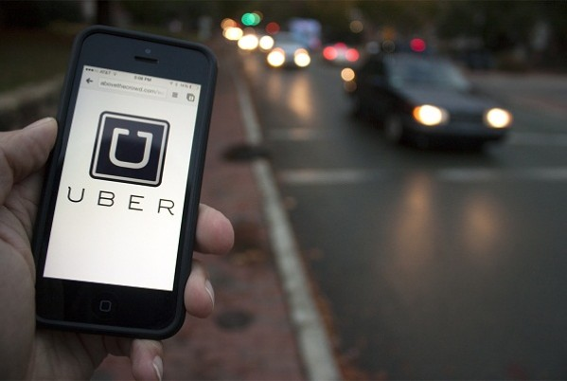
UBER
2014-2015
By
Khushboo Nandal

Slide 2
CONTENT
UBER Business Model.
How UBER works and make money?
Business problem statement.
UBER perk or benefits.
UBER analysis from April to September 2014.
Uber analysis from January to June 2015.

Slide 3
Uber Business Model
What really works for the cab-ride company Uber is an effective Business Model. Uber tries raking in plenty of prospective drivers who can bring in their own cars. What follows is a decidedly arrayed transportation network with efficient distribution.
Uber Target Audience
Uber is a platform application for all age and social groups. Office and college goers find it useful to book a ride with Uber in case of unavailability of other forms of public transport. When it comes to private means of transport, Uber is still an enterprising alternative in situations when the vehicle has suffered a breakdown. In some cases, Uber provides a cheaper alternative than private cars. Tourists on the run from one spot to another, or from airports and stations to their destinations and vice versa hold Uber in high regard. Be it attending an important event, making it to a meeting when you are running out of time, escaping on a rainy day, or going shopping – Uber is a one-stop solution.

Slide 4

How Uber Works & Makes Money?
There are two primary ways Uber makes money – and these are pretty simple on the surface. One way is by charging their customer for rides. The second is through promotional offerings and partnerships involving third parties.
Uber collaborates with vehicle owners and drivers and together they set up a minimum charge at which the partners will operate. Uber supplies them riders through online bookings from one single application and charges some amount of commission from them. The commission charged by the company ranges from 20% – 25% of the total amount charged from the customer.

Slide 5
Business problem statement
To find total journeys by Uber per month based on pick-ups per day-to meet customer requirement.
To find peak hour of the day to ensure quick response.
To find rush-hour of the day to ensure availability.
To find off-peak hours to make effective use of time.
To analyze Uber’s progress in 2014 and 2015, based on available data.
To find out Uber’s growth rate based on 2014 and 2015 journeys.

Slide 6

UBER perk:
No refusal, unless in extreme cases when the driver can’t make it to the location within time, or when there are no cars available.
The system of reviewing and rating a ride, as well as complaining in case of any mishap is something taxis are lacing in.
The time constraint within which the cab is going to show up is always mentioned before a ride.
The driver can be contacted and all his details, including contact number and car details are shown to the client before the ride commences.
The route could be altered as per the flexibility of the client
The rates are reduced considerably in the case of UberPool – a ride-sharing service.
There are a variety of car types to choose from depending on the number of people and also on the standard of the ride.

Slide 7
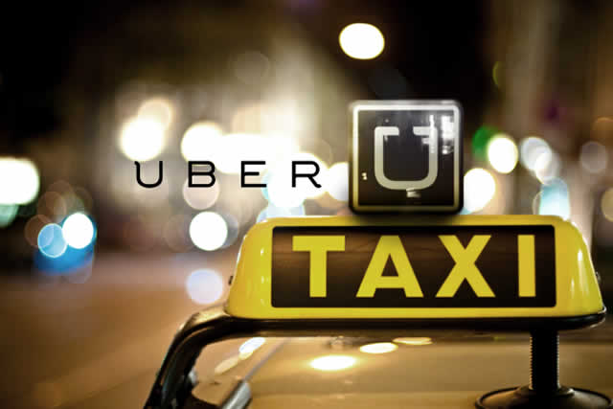
APRIL – SEPTEMBER 2014
This Photo by Unknown Author is licensed under CC BY-SA
This Photo by Unknown Author is licensed under CC BY

Slide 8
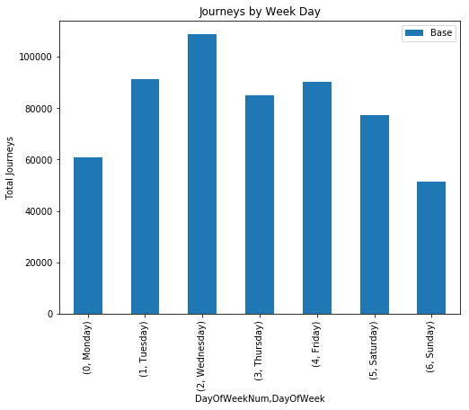
Uber had highest number of pick-ups on weekdays as compare to weekend.
Graph indicates number of Uber journeys on Wednesday being the highest , followed by Tuesday & Friday, where as Journeys on Monday being the lowest as compare to Thursday.
When it comes to weekend Uber had lowest number of pick-ups on Sunday as compare to pick-up on Saturday.
TOTAL JOURNEY PER DAY BY UBER IN APRIL 2014
IN NEW-YORK CITY

Slide 9
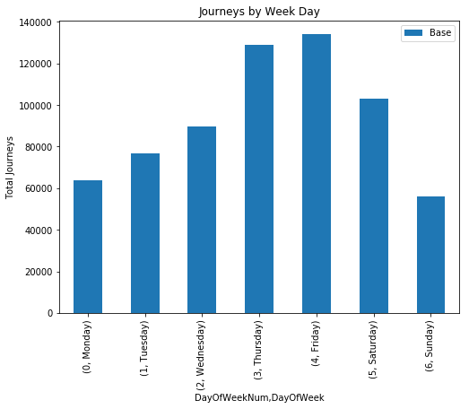
Uber had highest number of pick-ups on weekdays as compare to weekend.
Graph indicates highest number of Uber journeys on Friday and then on Thursday where as Journeys from Monday to Wednesday shows a marginal increase.
When it comes to weekend Uber had lowest number of pick-ups on Sunday as compare to pick-up on Saturday.
TOTAL JOURNEY PER DAY BY UBER IN May 2014
IN NEW-YORK CITY

Slide 10
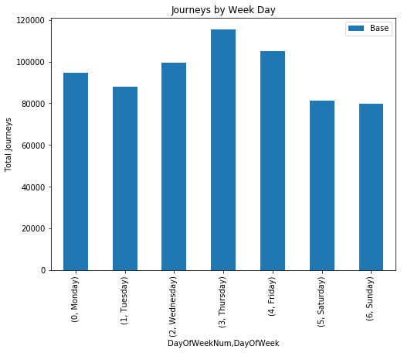
Uber had highest number of pick-up on weekdays and weekend.
Graph indicates highest number of Uber journeys on Thursday with variance on other weekdays.
Remarkable increase in the number of journeys on the weekend this month.
TOTAL JOURNEY PER DAY BY UBER IN June 2014
IN NEW-YORK CITY

Slide 11
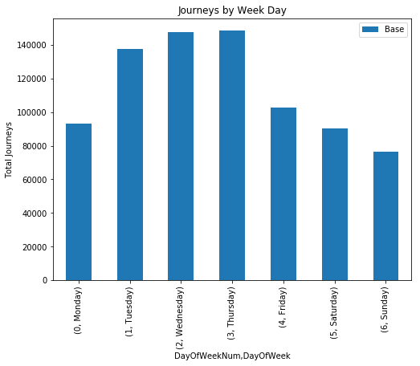
Uber had highest number of pick-up on weekdays then on weekend.
Graph indicates an upturn in the total number of journeys from Monday to Thursday with an exceptional decline on Friday .
Remarkable increase in the number of journeys on the weekend this month.
TOTAL JOURNEY PER DAY BY UBER IN July 2014
IN NEW-YORK CITY

Slide 12
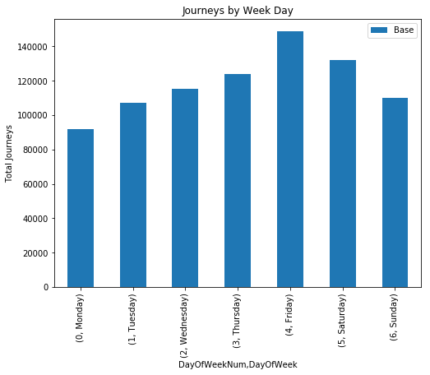
Uber had highest number of pick-up on weekdays then on weekend.
Graph indicates an escalation in the total number of journeys from Monday to Friday .
Remarkable hike on Saturday than on Sunday in the number of journeys.
TOTAL JOURNEY PER DAY BY UBER IN August 2014
IN NEW-YORK CITY

Slide 13
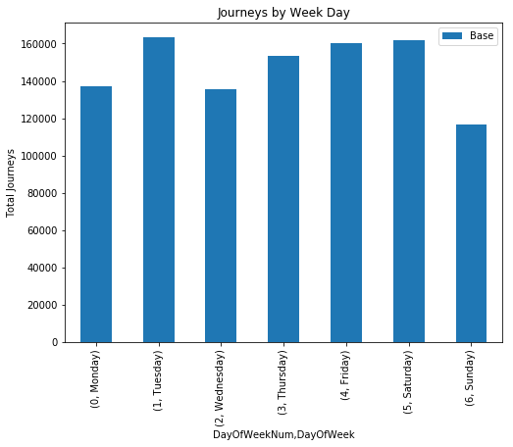
Uber had highest number of pick-ups through-out the month.
Graph depicts an fluctuation in the total number of journeys.
Tuesday and Friday being the highest on weekdays and Saturday on the weekend.
TOTAL JOURNEY PER DAY BY UBER IN September 2014
IN NEW-YORK CITY

Slide 14
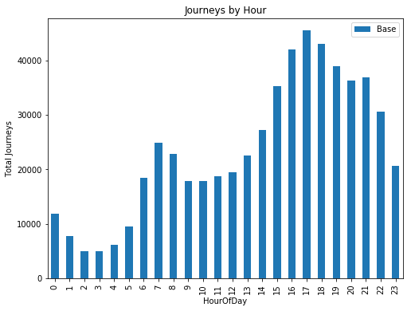
Uber’s peak-hour flow is from 3 to 10 pm.
The 5 o’ clock rush hour is Uber’s peak business time .
Off-peak time, is normally around midnight and early morning.
TOTAL JOURNEY PER HOUR BY UBER IN April 2014
IN NEW-YORK CITY

Slide 15

Uber’s peak-hour flow is from 3 to 6 pm.
The 5 o’clock rush hour is Uber’s peak business time.
Off peak-time is normally around 1 to 5 am.
TOTAL JOURNEY PER HOUR BY UBER IN May 2014
IN NEW-YORK CITY

Slide 16
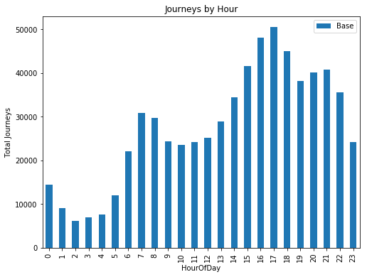
Uber’s peak-hour flow is from 3 to 6 pm .
The 5 o’ clock rush hour is Uber’s peak business time.
Off peak-time is normally around 1 to 5 am.
TOTAL JOURNEY PER HOUR BY UBER IN June 2014
IN NEW-YORK CITY

Slide 17
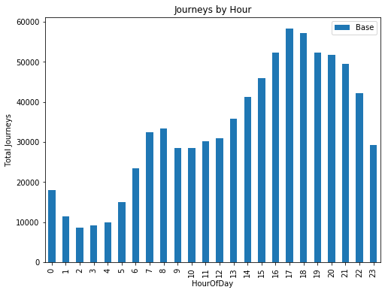
Uber’s peak-hour flow is from 4 to 8 pm.
5 o’ clock and 6 o’ clock rush hour is Uber’s peak business time.
Off peak time is normally around 1 to 5 pm.
TOTAL JOURNEY PER HOUR BY UBER IN July 2014
IN NEW-YORK CITY

Slide 18
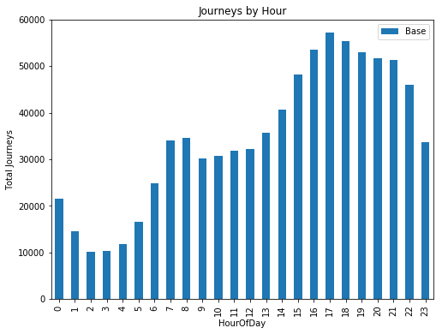
Uber’s peak-hour flow is from 3 to 9 pm.
5 o’ clock & 6 o’clock rush hour, is Uber’s peak business time.
Off peak-time is normally around 1 to 4 pm.
TOTAL JOURNEY PER HOUR BY UBER IN August 2014
IN NEW-YORK CITY

Slide 19
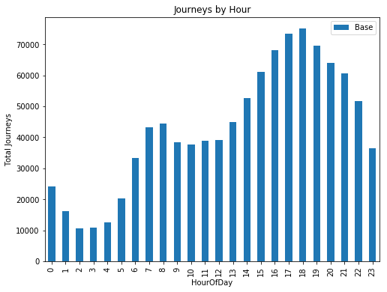
Uber’s peak-hour flow is from 3 to 6 pm.
5 o’ clock & 6 o’clock rush hour is Uber’s peak business time.
Off peak-time is around 2 to 4 am.
TOTAL JOURNEY PER HOUR BY UBER IN September 2014
IN NEW-YORK CITY

Slide 20
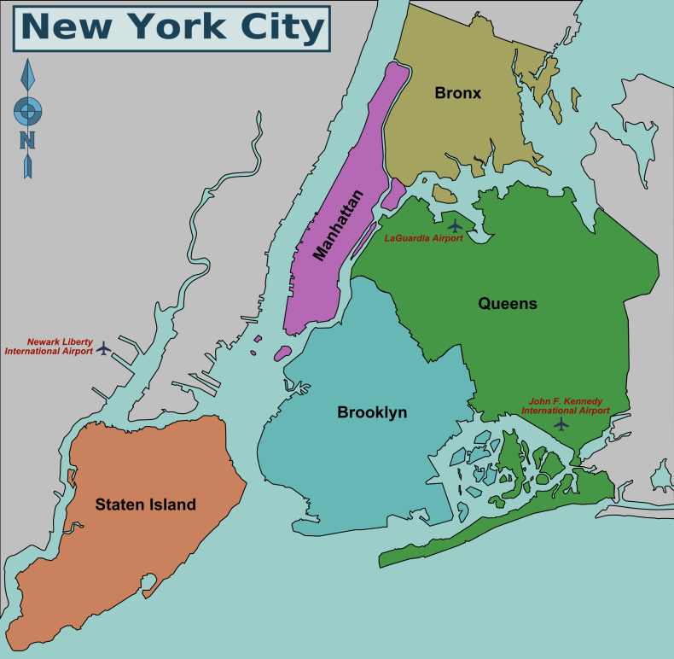
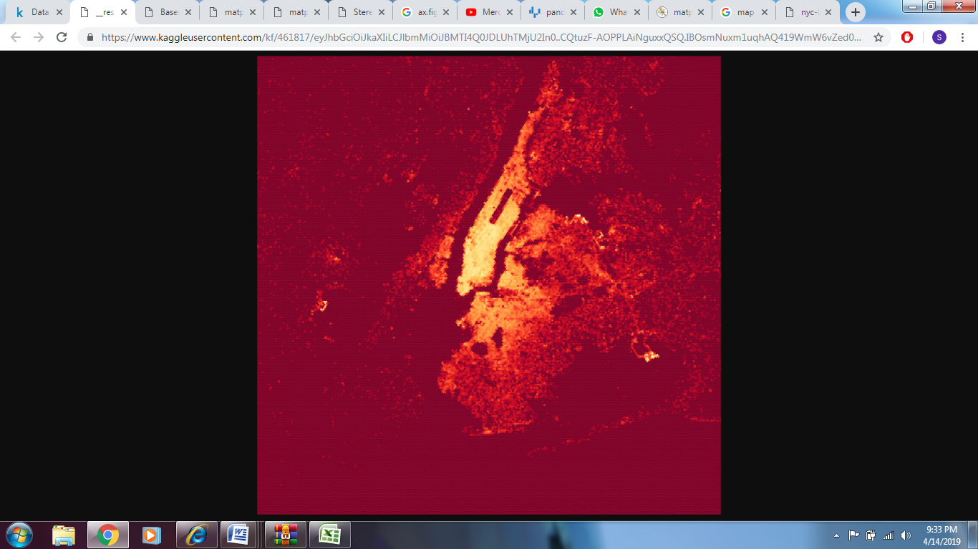
MAP vs HEAT MAP

Slide 21
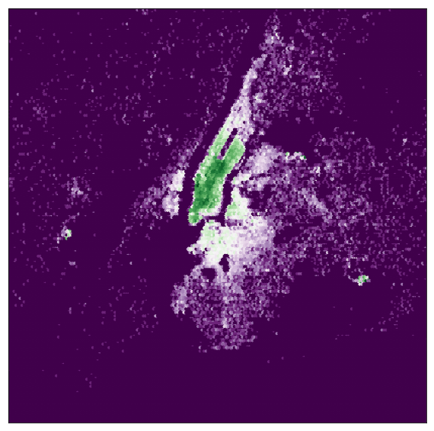

HEAT MAP
Uber’s traffic, represented as colors in various parts of the city.
APRIL 2014

Slide 22
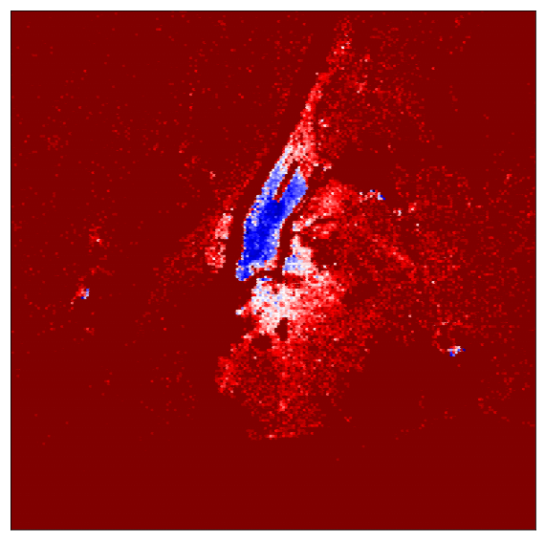
HEAT MAP
Uber’s traffic , represented as colors in various parts of city.
MAY 2014

Slide 23
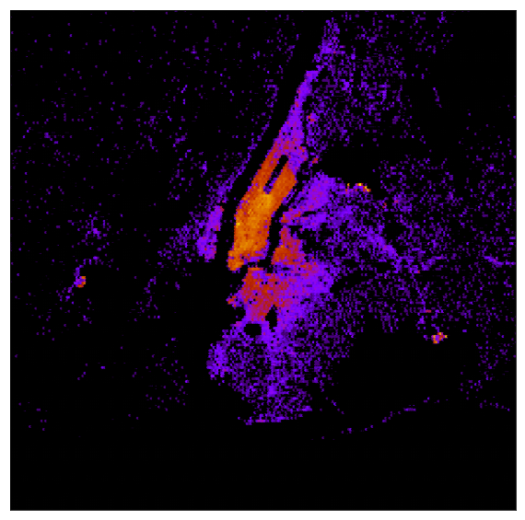
HEAT MAP
Uber’s traffic, represented as colors in various parts of the city.
JUNE 2014

Slide 24
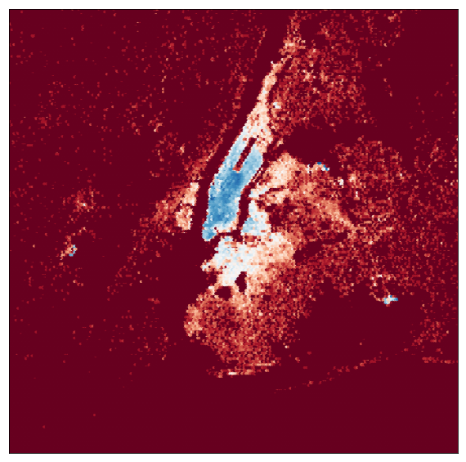
HEAT MAP
Uber’s traffic , represented as colors in various parts of the city.
JULY 2014

Slide 25
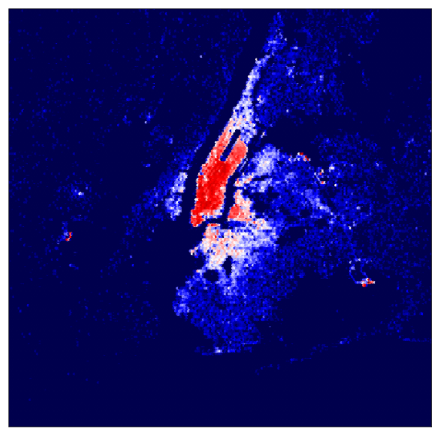
HEAT MAP
Uber’s traffic , represented as colors in various parts of city
AUGUST 2014

Slide 26
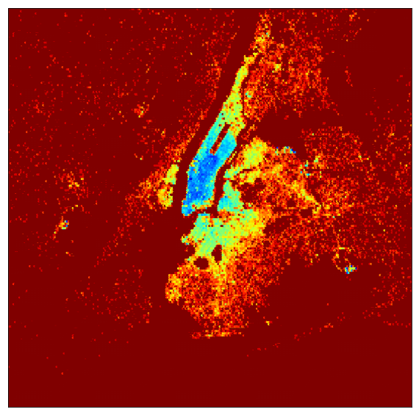

HEAT MAP
Uber’s traffic , represented as colors in various parts of cities.
SEPTEMBER 2014

Slide 27
JAN-JUNE 2015
This Photo by Unknown Author is licensed under CC BY-SA

Slide 28
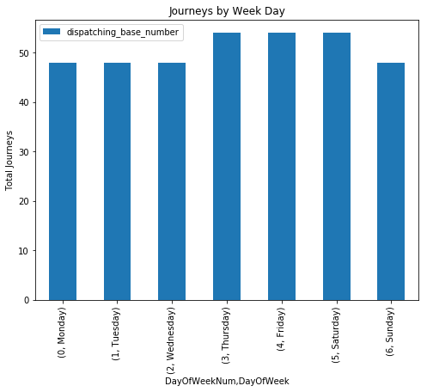
Uber had sky-high pick ups throughout the weeks.
Graph depicts an escalated number of journeys from Thursday to Saturday as compare to Monday to Wednesday and Sunday with a slight difference.
TOTAL JOURNEY BY UBER PER DAY during JAN-FEB 2015
IN NEW-YORK CITY

Slide 29

Graph shows number of active vehicles during the weeks with total trips completed by Uber.
A slight fluctuation can be seen with maximum trips throughout the week.
UBER’S ACTIVE VEHICLES PER DAY during JAN-FEB 2015
IN NEW-YORK CITY

Slide 30
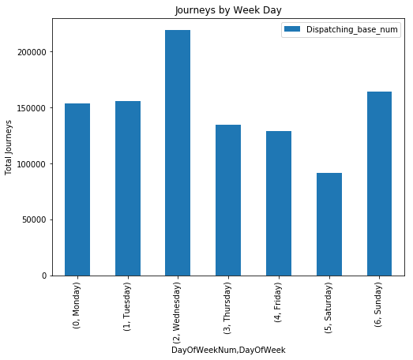
Graph depicts a fluctuation in the number of journeys with a rise on Wednesday.
Wednesday and Sunday holds the maximum pick-ups .
Saturday holds the minimal pick-ups of all days.
TOTAL JOURNEYS BY UBER PER DAY during JAN-JUNE 2015
IN NEW-YORK CITY

Slide 31
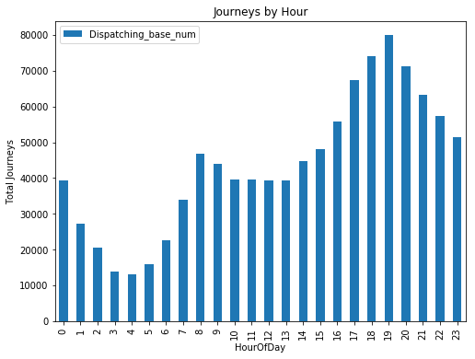
Uber’s peak-hour flow from4 to 9 pm.
7 o’ clock rush hour is Uber’s peak business time.
Off-peak time is around 3 to 5 am.
TOTAL JOURNEYS BY UBER PER HOUR during JAN-JUNE 2015
IN NEW-YORK CITY

Slide 32

Graph indicates number of journeys with affiliated base number from Jan to June 2015.
Remarkable hike on Wednesday as compare to other days.
TOTAL JOURNEYS BY UBER with Affialiated_Base_Number
JAN-JUNE 2015
IN NEW-YORK CITY

Slide 33
T H A N K Y O U

